Slide 1
What can do for numerical computation?
黃聰明
臺灣師範大學 數學系
min@ntnu.edu.tw
數值分析  2012年 2月20日

Slide 2
雷射光上多重訊號的保密通訊

Slide 3
Self-pulsating laser diodes equation

Slide 4
Numerical simulation of the solution

Slide 6
Partial Differential Equation
where for , and is the unit ball in .

Slide 7
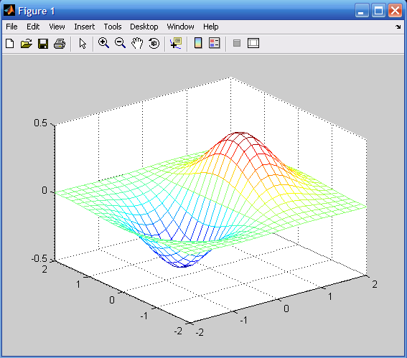
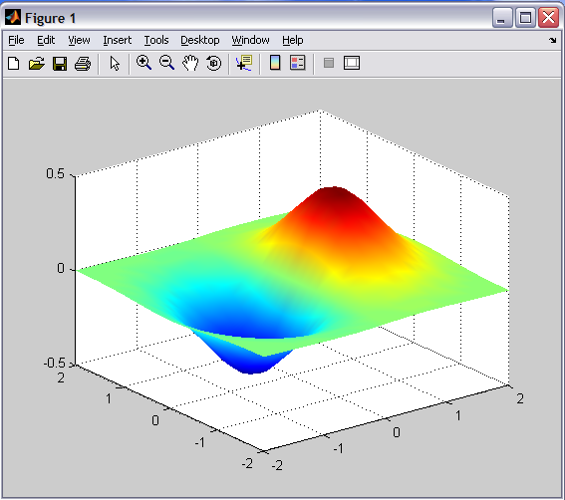
離散化

Slide 8
Linear System
The discretization forms the following linear system
where

Slide 9
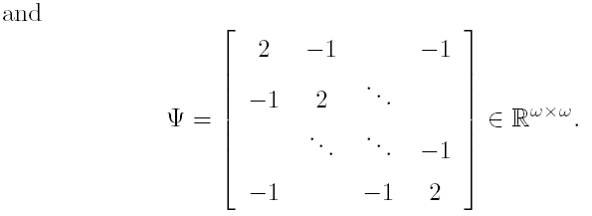

Slide 11
Numerical simulation of nano-scale semiconductor

Slide 12
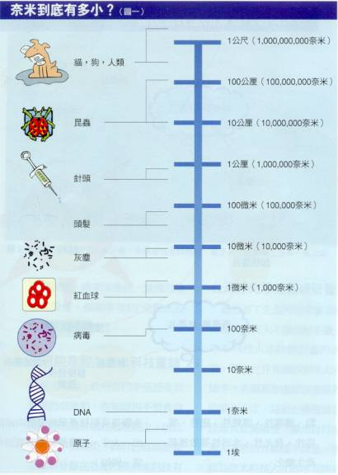
Nanometer
It is a small world, with a plenty rooms.
Why consider quantum effects? Small devices imply significant quantum effect.
1 nm = m Nano-scale ≈ 1-100 nm
A semiconductor QD ≈ 10 nm (QD:hair ≈ 1:10,000)
Semiconductor QD

Slide 13
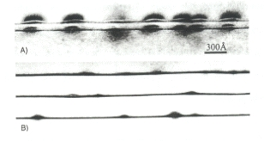
Quantum dots
Cross-sections of hetero-structure InAs/GaAs QDs by Transmission Electron Microscope [Schoenfeld, 00]
150 Å
300 Å

Slide 14
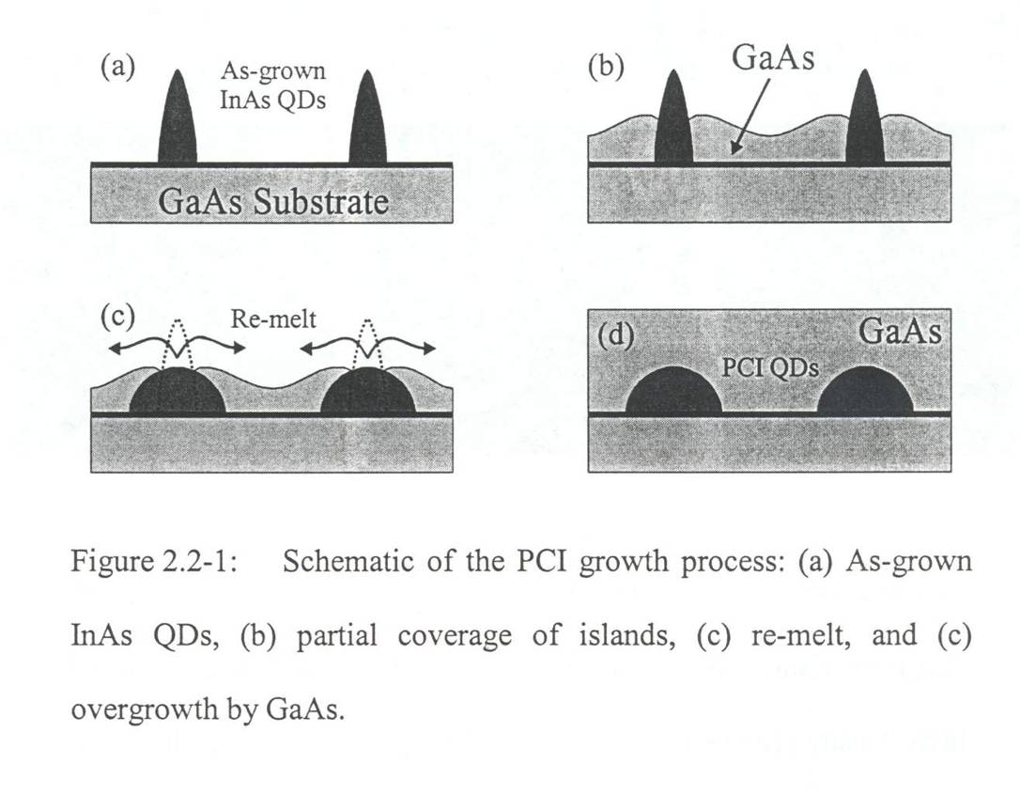
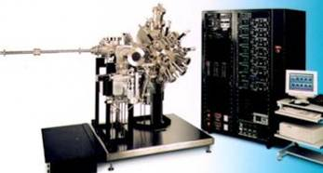
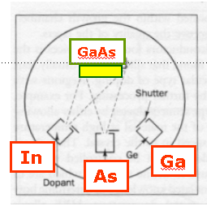
Nano-scale quantum dot fabrication
E-beam, chemical solution,… (bigger QDs)
Molecular beam epitaxy (smaller QDs)

Slide 15
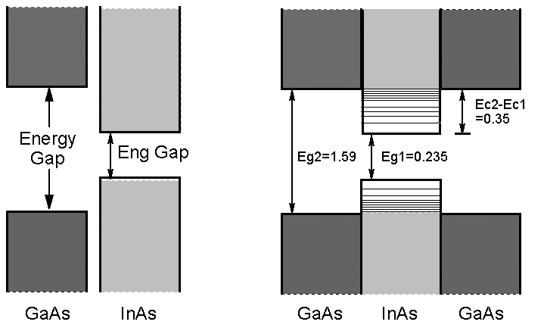
Confinement (band gap engineering)
Energy

Slide 16
The Schrödinger equation
ħ: reduced Plank constant
λ: unknown eigenvalue; u(x,y,z): unknown eigenvector
m: effective mass; V: confinement potential m and V are discontinuous across the heterojunction
BenDaniel-Duke interface cond.
Dirichlet boundary cond.

Slide 17
Effective mass models
Constant model
Non-parabolic model
the momentum, main energy gap, and spin-orbit splitting in the lth region, respectively.

Slide 18
The eigenvalue problems
Constant effective mass model
Non-parabolic effective mass model: multiply the common denominator

Slide 19
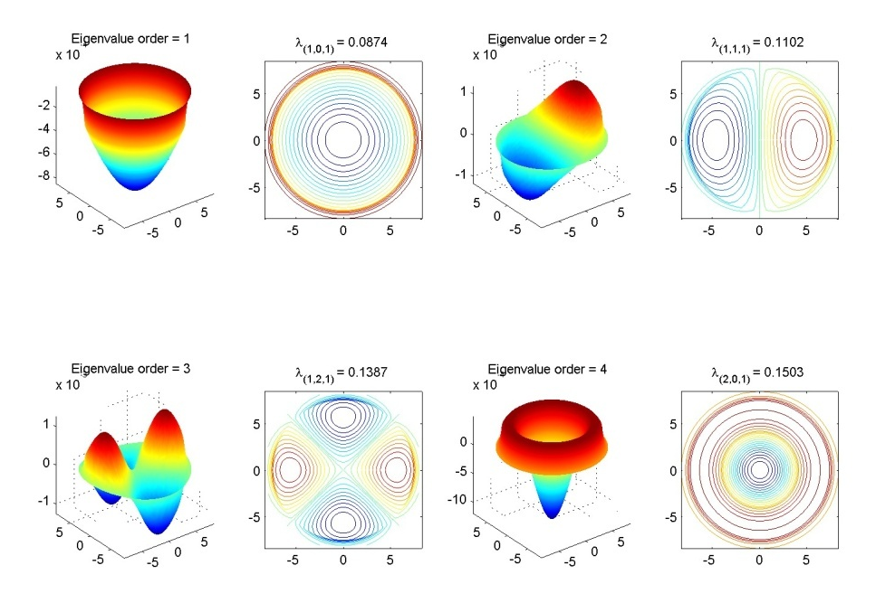
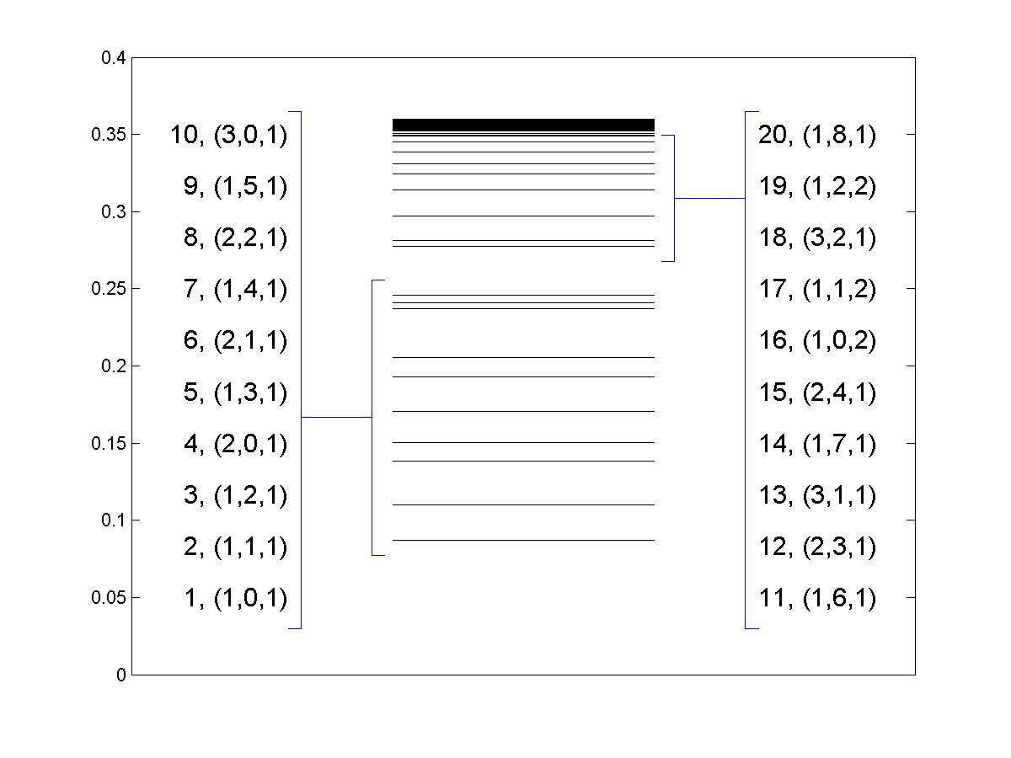
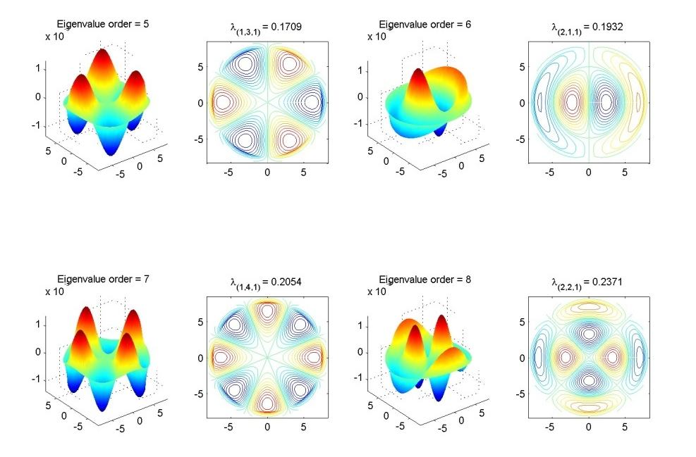
Energy states spectrum and wave functions

Slide 20
Resonances in rail tracks excited by high speed trains
With new ICE trains crossing Europe at speeds of up to 300 km/h, sound and vibration levels in the trains are an important issue.
Hilliges/Mehrmann/Mehl(2004) first proposed this problem on a project with company SFE GmbH in Berlin.

Slide 21
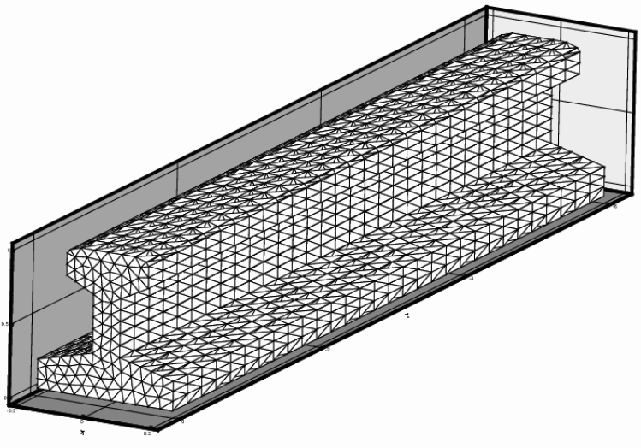
Finite Element Model
A 3D finite element discretization of the rail with linear isoparametric tetrahedron elements produces an infinite-dimensional system of O.D.E.:
where M, D and K are block-tridiagonal matrices

Slide 22
Palindromic Quadratic Eigenprobelm
The system is periodic and leads to a Palindromic QEP:
where , and

Slide 23
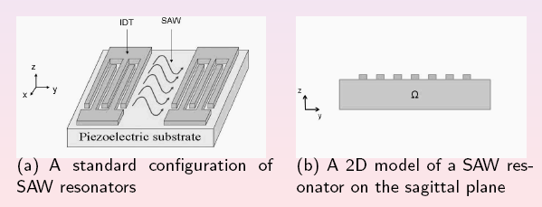
Surface Acoustic Wave Filter(表面聲波濾波器)
為手機的關鍵零組件。表面聲波濾波器(SAW Filter)可被廣泛應用在各種無線通訊系統、電視機、錄放影機及全球衛星定位系統接收器上。主要功用在於把雜訊濾掉，比傳統的LC濾波器安裝更簡單、體積更小。
SAW元件主要作用原理是利用壓電材料的壓電特性，利用輸入與輸出換能器（Transducer）將電波的輸入訊號轉換成機械能，經過處理後，再把機械能轉換成電的訊號，以達到過濾不必要的訊號及雜訊，提昇收訊品質的目標。

Slide 24
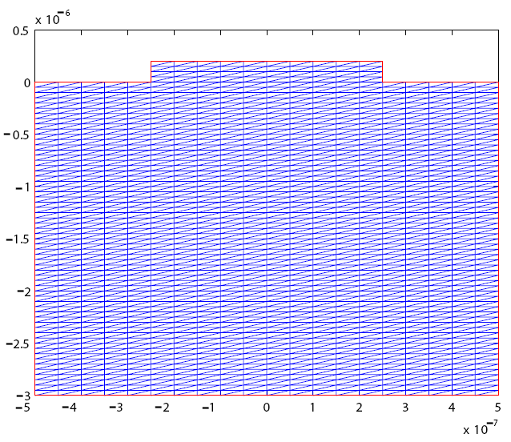
Finite element discretization
Palindromic Quadratic Eigenvalue Problem
where , and

Slide 25
光子晶體
光子晶體是週期性的介電質材料
在介電係數呈週期性排列的三維介電材料中，電磁波經介電函數散射後，某些波段的電磁波強度會因破壞性干涉而呈指數衰減，無法在系統內傳遞，相當於在頻譜上形成能隙，導致色散關係具有帶狀結構，此即所謂的光子能帶結構(photonic band structures)
具有光子能帶結構的介電物質，就稱為光能隙系統(photonic band-gap system)，或簡稱光子晶體(photonic crystals)。
科學家利用光子晶體的這個性質來做光導，也就是利用光子晶體把特定波長的光限制在某個區域或路徑中。這種光導可以用在光通訊上傳遞光訊號或作為雷射的共振腔。

Slide 26
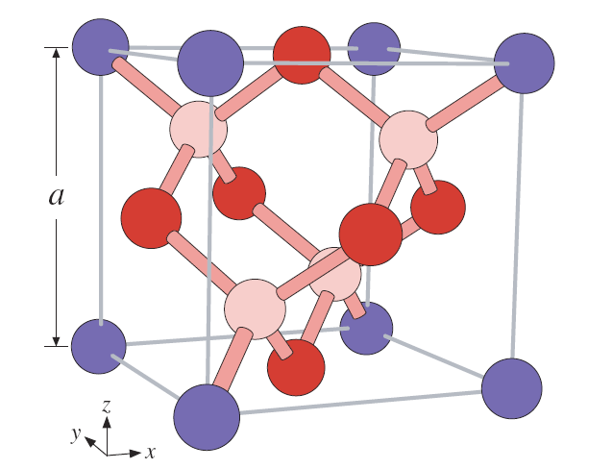
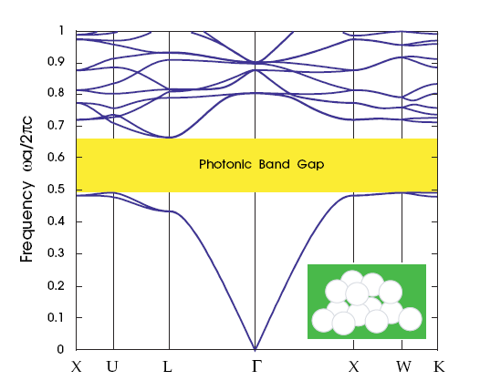

Slide 27
Maxwell Equation
Maxwell equation
E: electric field, H: magnetic field
Time Harmonic modes
Generalized eigenvalue problem

Slide 28
Summary
The 3D model: Schrödinger eqs. with constant or non-parabolic effective mass approx.
Concerning issues: eng. level & wave ft.
Computed results verifications, explanations, applications
Science and Engineering
Applied Mathematics
Discretization scheme -- non-uniform mesh, uniform mesh -- finite-diff. on cylindrical cord. and
curvilinear cord.
-- finite-volume on Cartisian and cylindrical coordinate
Large-scale matrix computation -- matrix reduction -- polynomial eigenvalue solver -- deflation scheme -- accelerator
Practical algorithms (for a certain architecture and language)
Robust & efficient implementations
Numerical experiments
Computational and visual results
Computer Science

